Slide 1
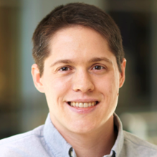



Missing links in the Pre-Trained Neural Network Supply Chain
James C. Davis
davisjam@purdue.edu
Notes:
Hi, James Davis from ECE @ Purdue University.
Acknowledge support from NSF, Google, and Cisco, without whose support I could not conduct this work.
I also want to thank my collaborators, most notably my collaborators Drs. George Thiruvathukal and Yung-Hsiang Lu, and students leading these projects including Wenxin Jiang, Nicholas Synovic, Jason Jones, and Purvish Jajal.

Slide 2
Synopsis
PICTURE: computer vision
PICTURE: autonomous vehicle
PICTURE: cybersecurity log analysis + a dashboard
Picture: Growth in model complexity over time (simple sketch figure, not detailed)
Picture: Copy/paste, links in a chain
Picture: Investigator, with questions like ““Why?”, “Practices?” “Challenges?”
Notes:
* Deep neural networks are widely used in computing systems, from image recognition in autonomous vehicles to detecting anomalies in system logs.
* Creating and specializing neural networks is growing more difficult as state-of-the-art architectures grow more complex.
* Following the path of traditional software engineering, machine learning engineers have begun to exchange and reuse pre-trained neural networks (PTNNs). When re-using a PTNN, an engineer can focus on fine-tuning it for downstream tasks. Understanding this software engineering process is the first step to optimizing and securing it, e.g. through model search engines for reuse, improved testing techniques for validation, and better definitions for PTNN packaging. However, the details of real-world PTNN reuse remain unknown.
* In this talk I present results from the first empirical software engineering projects to define the PTNN supply chain and evaluate aspects of trust in this context.

Slide 3
Talk overview
My research approach
Background
Research and results
Future directions

Slide 4
Talk overview
My research approach
Background
Research and results
Future directions

Slide 5
Two primary kinds of (software engineering) research
Observations
Open problems
Solutions
Notes:
The purpose of research is to discover new knowledge. This knowledge (ideally) addresses open problems in the field.
Solving: Traditional engineering research. Apply techniques such as static and dynamic analysis to improve some aspect of software engineering.
Searching for code
Refactoring programs
Finding vulnerabilities
…
But equally important is continually recharging the pool of open problems. In computing, engineers are constantly needing to adapt to new technologies – hardware, operating systems, programming languages, etc. – and so if we only solve “old” problems we will lose touch with practitioners.
Discovering: Ensuring that the problems the research community solves are aligned with the problems that engineers actually have
Mining software repositories
Studying engineers’ behavior
“Empirical SWEng”
These two approaches are symbiotic.

Slide 6








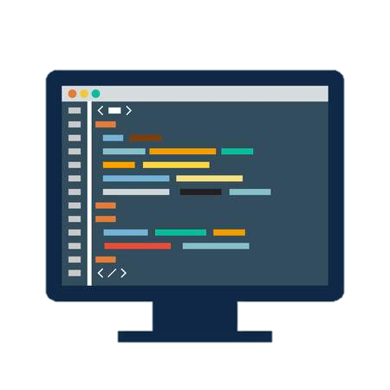

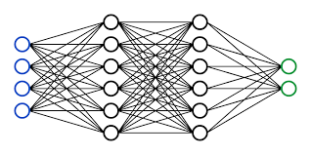



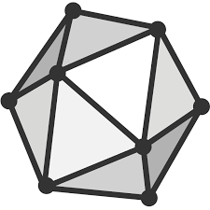
Notes:
Consider the software engineer.
* What tasks do they perform?
- Lots of traditional activities such as computer programming, data management, data transmission, collaborative engineering, and deployment. More recently working with machine learning technologies such as neural networks.
What tools do they use to assist them in these tasks?
*Flip through some tool families
One aspect of software engineering research is to understand the ways that engineers use these tools, in order to
Identify problems with the tools
Identify ways we can improve these tools
Identify opportunities for new tools
When tools are used incorrectly, bad things happen.
The engineering process may be inefficient, or the quality of the engineering product may be affected.
TRANS
Today I’m going to talk about engineering practices and challenges for one of these domains: machine learning, and specifically, deep learning / neural networks.
=====
Editing:
VSCode
IntelliJ
Eclipse
Emacs
Interacting with data
MySQL
MongoDB (noSQL)
GraphQL
Communication:
JSON
Protobuf
Working with other developers:
Version control
CI tools like Travis
Virtualization:
- Docker
- Kubernetes
Deployment, e.g. serverless frameworks like
- AWS lambda
- Google cloud functions
Apache OpenWhisk
Neural networks:
- Development frameworks like PyTorch and TensorFlow; model hubs such as HuggingFace; exchange formats such as ONNX

Slide 7

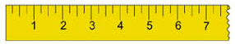
Not anecdotes but empiricism
Notes:
* Scientists and engineers need an empirical foundation on which to build.
Empirical research provides this foundation.
* We should study NN problems QUALitatively, engaging with software engineers to hear their perspectives and focus on the most important issues
* We should also study NN problems QUANTitatively, mining software repositories and production deployments to understand the NN problems that engineers encounter
TRANSITION
I’ll talk about research in both of these directions.

Slide 8
Talk overview
My research approach
Background
Research and results
Future directions
Notes:
Go reasonably fast through this, these are PhDs who presumably know the space a bit

Slide 9
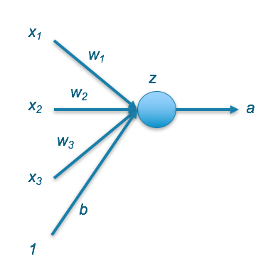
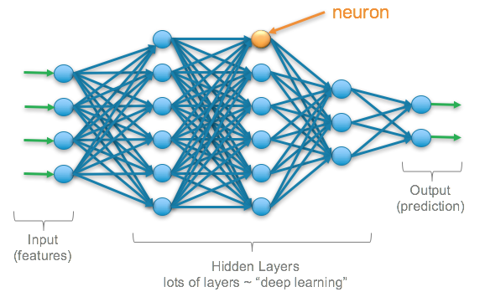


What is a neural network?
https://srnghn.medium.com/deep-learning-overview-of-neurons-and-activation-functions-1d98286cf1e4
Notes:
Neural networks can learn complex patterns using layers of neurons which mathematically transform the data
The layers between the input and output are referred to as “hidden layers”
A neural network can learn relationships between the features that other algorithms cannot easily discover
* An artificial neuron (also referred to as a perceptron) is a mathematical function. It takes one or more inputs that are multiplied by values called “weights” and added together. This value is then passed to a non-linear function, known as an activation function, to become the neuron’s output. The weights are parameters of the network – if you change the weights, you will change its behavior.
This is the simplest form of neural network: it’s a fully connected multi-layer perception. The design of a neural network appropriate for a given task has been a longstanding area of research, with new proposals every year that are made both manually and with the help of computer-aided design (NAS).
*
Once you have your network, you need a task for it to accomplish. Typically this task is encoded in a dataset, with lots of examples of inputs and expected outputs.
*
Then you need to identify the parameters (weight assignments) that will make the network perform well on the task. This is commonly implemented using an algorithm called gradient descent, where the network tries a candidate set of weights, scores its performance using a loss function, and then tweaks some of the weights in a way that will make it perform better next time. If you do that thousands and thousands of times, the network will eventually get pretty good at the task –potentially better than a human.
This simple neural network might be capable of guessing your home’s property value, or estimating your grade in a class. But it is small (relatively few parameters) and it probably won’t outperform a human expert thinking about many aspects of those tasks. However, over the past 20 years or so researchers have shown that large models can outperform human experts in tasks as diverse as playing Chess and Go, converting audio to text, translating prose from one language to another, and making medical diagnoses.

Slide 10
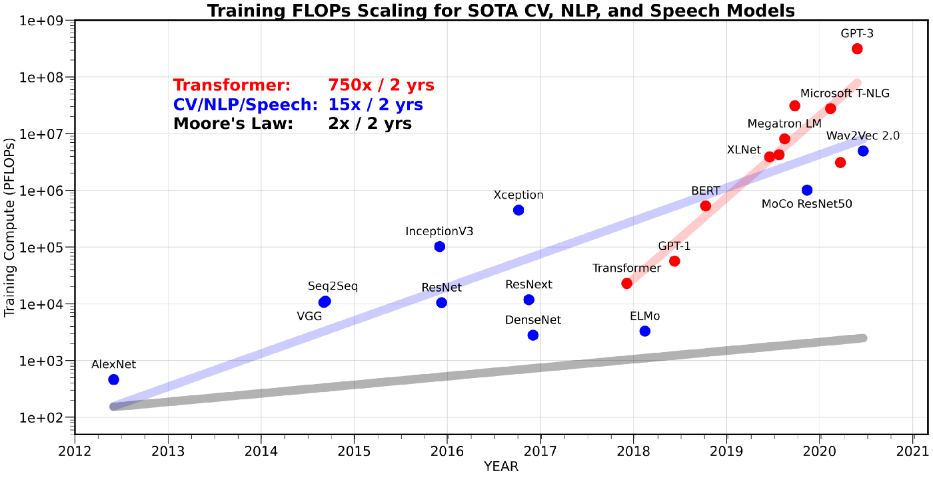
Huge models, huge training costs
175B parameters
110M parameters
60M parameters
Carbon footprint costs measured using BERT in 2019
Patterson et al., 2021 "Carbon emissions and large neural network training." arXiv preprint arXiv:2104.10350 (2021).
Gholami et al. 2021: https://medium.com/riselab/ai-and-memory-wall-2cb4265cb0b8
Strubell et al. 2019: https://arxiv.org/pdf/1906.02243.pdf
Notes:
The computational cost of training recent SOTA Transformer models in NLP has been scaling at a rate of 750x/2yrs, and the model parameter size has been scaling at 240x/2yrs. In contrast, the peak hardware FLOPS is scaling at a rate of 3.1x/2yrs, while both the DRAM and interconnect bandwidth have been increasingly falling behind, with a scaling rate of 1.4x/2yrs.
Computation isn’t free.
$$: Strubell et al., 2019: https://arxiv.org/pdf/1906.02243.pdf
-The direct financial cost of the requisite GPUs and compute servers, whether owned or rented through the cloud, is $100Ks and up.
-As of 2019, the approximate carbon footprint of training and optimizing one state-of-the-art DNN model is comparable to flying a full jet from NY to SF.
-Per the figure on this slide, that cost has gone up multiple orders of magnitude since then
Costs are correlated with number of parameters to be trained
AlexNet: 60M parameters
BERT: 110M parameters
GPT-3: 175B parameters

Slide 11
Pre-trained neural networks: Definition and Use
PTNN: A neural network that is already parameterized for an application
Example use: Transfer learning
Notes:
DNNs don’t need to be trained from scratch every time. It’s possible to use pre-trained models instead.
PTNN: This parameterization – weights associated with the neural network – is also called a checkpoint, since it is taken during the training of the neural network model
They allow the user to focus on fine tuning which is arguably easier than training from scratch
PTNN's trained on large datasets are often good at generalizing to other domains, having access to these PTNN' is very convenient
An example use:
Deep neural network previously trained on a large dataset to solve a particular task, such as image classification.
Transfer learning: The user starts with a pre-trained neural network for a GENERAL task, and specializes it to their specific task. The user can take the generic part of a network and add trainable layers specific to the new task. The PTNN is used as a backbone (baseline feature extractor). This approach supports innovation, since many different datasets and downstream model layers can be explored on top of the backbone.
============
PTNNs are also used for knowledge distillation. It essentially acts as a form of model compression, where the learned weights and biases of either the input layer, hidden layers, or the output layer is transferred to a smaller model. Unlike the previous two methods, the knowledge from the cumbersome model is now distilled and input into the smaller model. For smaller mobile applications and systems with limited computational capacity, knowledge distillation allows for a compressed model to learn from this larger network [1].
Finally, dataset labeling is a large benefit from pretrained neural networks. With the onset of these large models, accuracy and generalization become a large part of the equation. As such, specific PTNNs have the capability to help users with smaller models label datasets to a great degree of accuracy. Instead of having to go through thousands of images, it’s possible for input data to be quickly labeled and used for training.
[1] https://arxiv.org/pdf/2006.05525.pdf

Slide 12
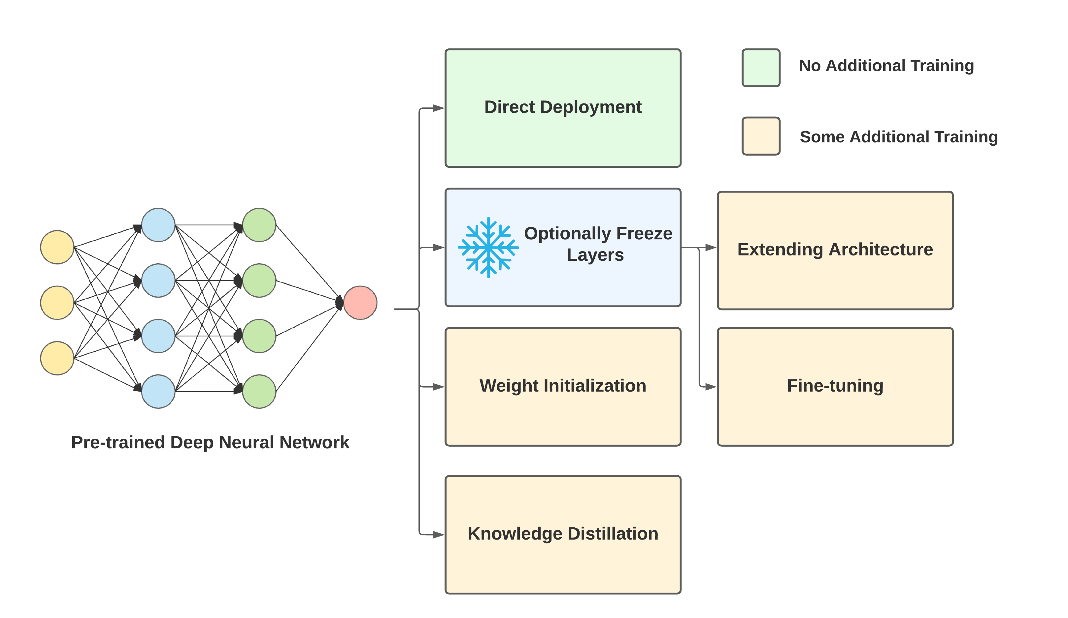

A bit more on PTNN re-use
2
Notes:
Re-using PTNNs can accelerate model development.
Transfer learning can reduce training times and increase accuracies.
Things are a little more complex than this – after getting the PTM to the desired performance, may need to convert it to a format suitable for deployment (e.g. for a hardware accelerator). The industry has converged to a “compiler” toolchain called ONNX for this purpose.

Slide 13
Talk overview
My research approach
Background
Research and results
Future directions
References
Montes et al., ACM ESC/FSE-IVR 2022
Jiang et al., ACM SCORED 2022
Jiang et al., ICSE 2023
Davis et al., JVA 2023
(Some work in progress)
http://davisjam.github.io/publications
Notes:
I’ll start with the software engineering-conceptual framework: I view PTMs as a new form of software reuse

Slide 14

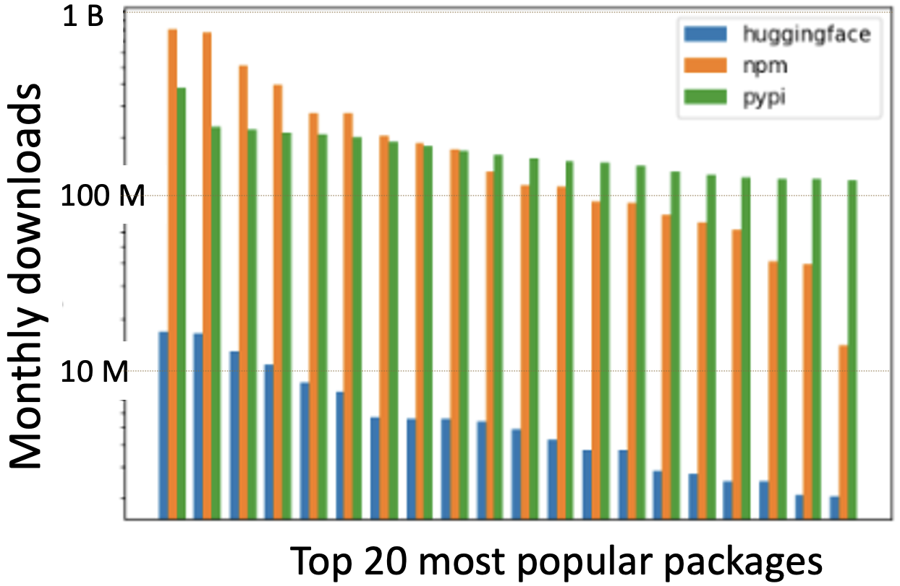



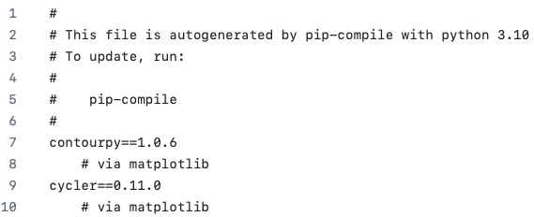

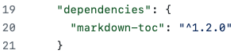
Pre-trained models ~~ traditional software package reuse
HuggingFace
npm
PyPi
Notes:
Data as of 2022

Slide 15

Engineering reuse process
“Has someone done this already?”
Deploy
Any danger?
“Yay!”
Adapt candidate(s)
What is prioritized?
What is challenging?
“Have to reframe my problem’s constraints”
Evaluate candidates
What is available?
What are the risks?
“Need production quality – wins”
Identify candidates
“Dragonfly, Playtypus, parMOO, …”
Specify problem
Repeat as needed
“I want a multiobjective optimization solver”
What if we fail to re-use?
Notes:
Audience engagement – Help me through animation, and did I miss any steps?
Of course, doesn’t always work in a linear way.
Sequence for ParMOO
What about for PTMs? Should work in a similar way – walk through verbally
- Pop up RQs we consider

Slide 16
Engineering reuse process
Deploy
Any danger?
Adapt candidate(s)
What is prioritized?
What is challenging?
Evaluate candidates
What is available?
What are the risks?
Identify candidates
Specify problem
What if we fail to re-use?
Notes:
Audience engagement – Help me through animation, and did I miss any steps?
Of course, doesn’t always work in a linear way.
Sequence for ParMOO
What about for PTMs? Should work in a similar way – walk through verbally
- Pop up RQs we consider

Slide 17
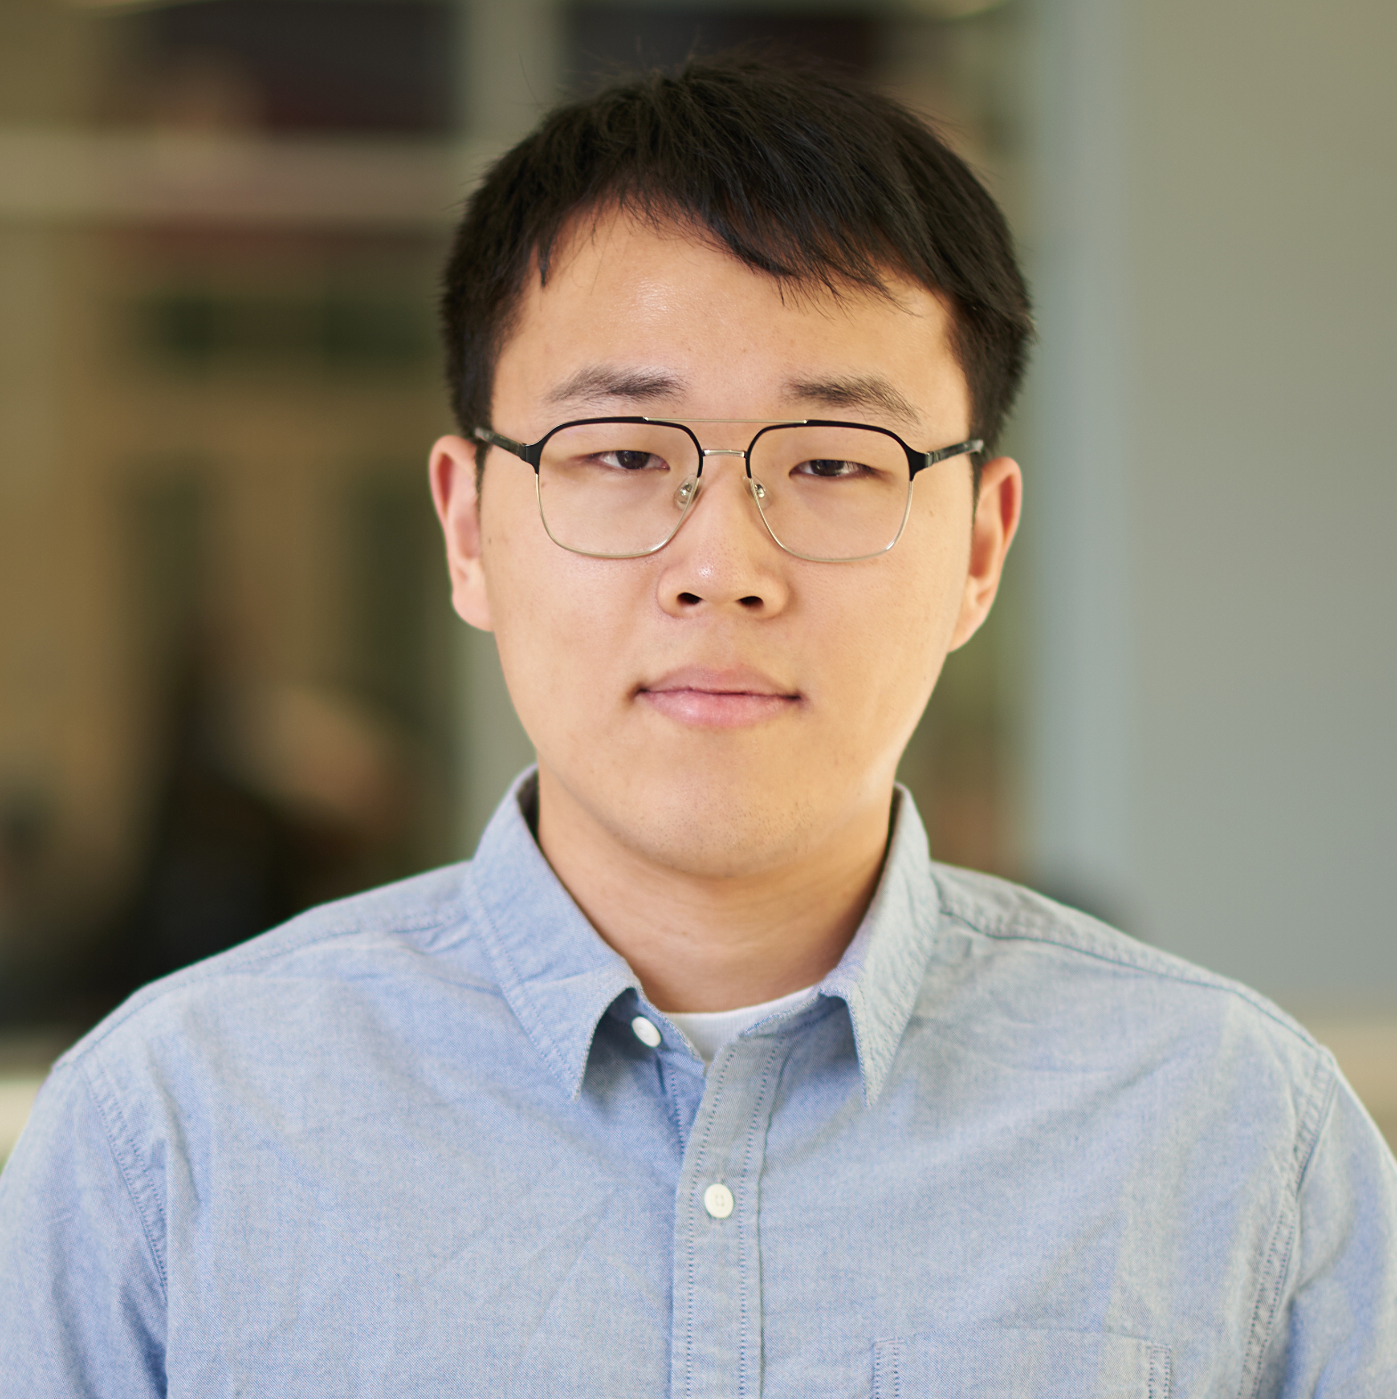



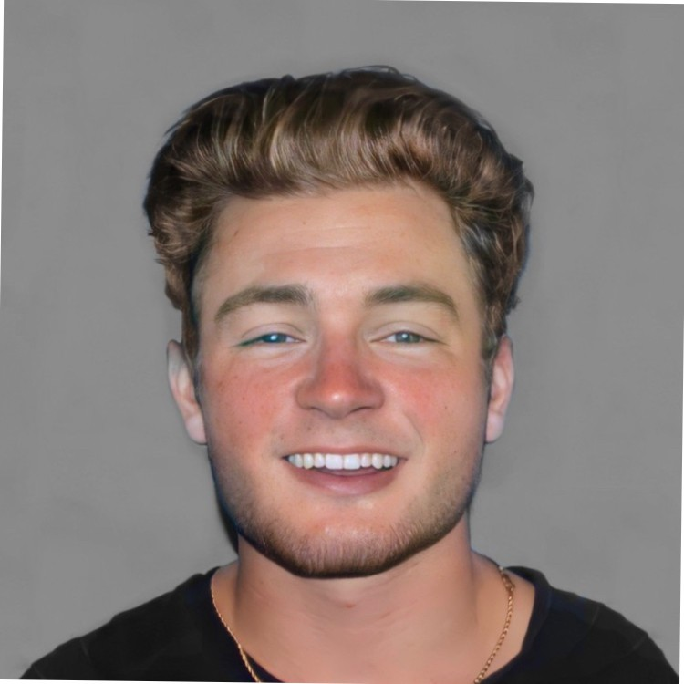
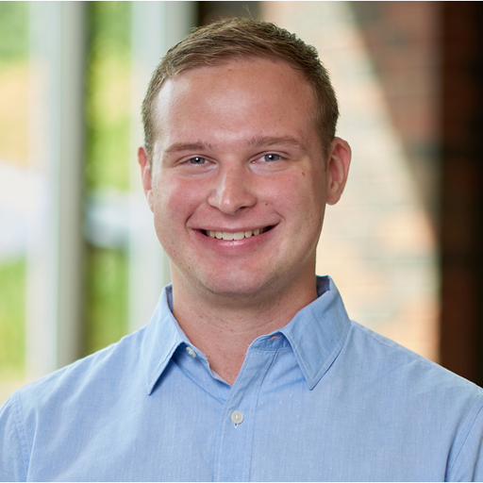
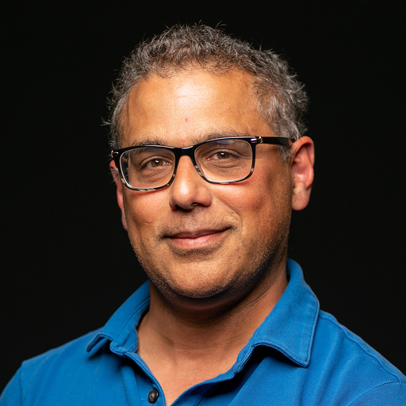
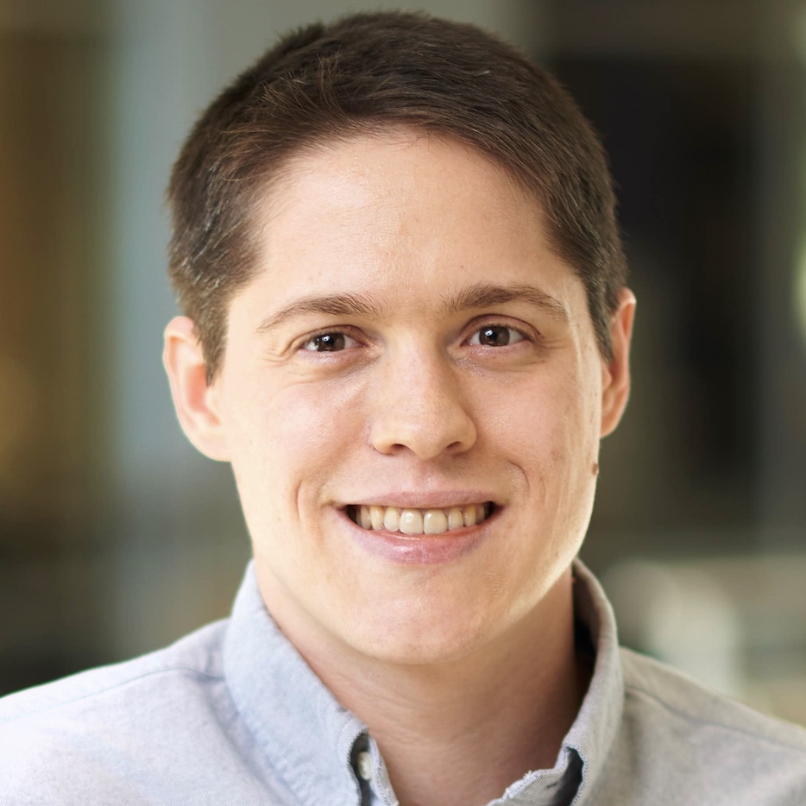





An Empirical Study of Artifacts and Security Risks in the Pre-trained Model Supply Chain
Wenxin Jiang Nicholas Synovic Rohan Sethi
Aryan Indarapu (UIUC) Matt Hyatt Taylor R. Schorlemmer
George K. Thiruvathukal James C. Davis
In collaboration with

Slide 18
Contributions
Measure the artifacts in 8 model hubs and depict the PTM supply chain
Threat models and potential risks
Directions to address the security vulnerabilities on model hubs
18
Notes:
We measured the artifacts in 8 model hubs, identified the typical structures, and depicted the PTM supply chain.
We also reviewed existing security defenses and analyzed potential threat models. Our analysis shows that existing defenses are insufficient for ensuring the security of PTMs distributed in model hubs.
We also inform future directions to address the security vulnerabilities.

Slide 19

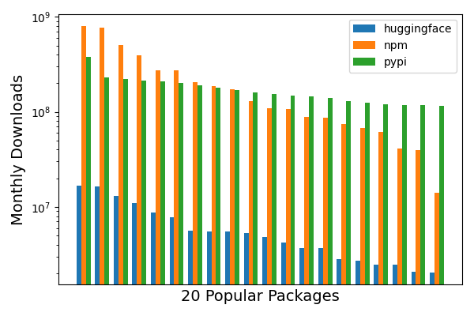


Model Hubs
What is it?
PTMs and datasets organized by problem domain.
Compared to traditional package registries
10,000,000+
19
Notes:
Model hubs:
Collections of Pre-trained Models and datasets organized by problem domain
To the best of our knowledge, the first model hub was introduced in 2018 from Google, which is TensorFlow hub.
Goal: help engineers better reuse these costly artifacts
(click)
Compared to traditional package registries:
HuggingFace is the largest model hub. It mainly provides language models.In August 2022, it had over sixty thousand public PTMs.
(click)
The downloaded rates of HF are comparable to the popular packages in npm and Pypi.
(click) The most popular four PTMs has over 10 million monthly downloads.
It’s also interesting that most of these 20 models are created by researchers from other companies, while the top-29 from npm and pypi are not.
Model hubs function as a research-to-practice pipeline which is different from npm and pypi

Slide 20
Research questions
What is the typical structure of model hubs?
What practices improve security in model hubs?
What are the potential threats in model hubs?
20
Notes:
We know what the attacks are, but the characteristics and practices of secure PTM supply chain have not been studied before,
To characterize the PTM supply chain, we ask the following three questions.
Typical structure: what artifacts are included? How could a model be contributed, distributed, and updated in model hubs?
What are existing security features in different types of model hubs?
What are the threat models and potential risks in different model hubs?

Slide 21
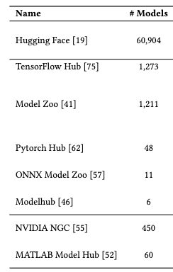
Model Hub Identification
Keywords in major search engine
Selection criteria: definition, website, documentation
Result: 8 model hubs
21
Notes:
Keywords: ML model hub, DL model hub
Selection criteria:
Match our definition of model hub (i.e. a collection of models and datasets organized by problem domain)
Should have a website -> instead of only have github repo
The documentation should be accessible -> analyze
Finally, we got 8 model hubs,
We analyzed the #models, #dataset, and, how the PTMs are contributed and distributed.

Slide 22
Results
22

Slide 23
RQ1: Typical Structure of Model Hubs
Three different types:
Open
← Anyone
Gated
← Approved contributors
Commercial
← Internal engineers
23
Notes:
We identify three different types: open, gated, commercial.
The types are determined by how the PTMs are contributed.
For example, in HuggingFace, anyone can upload and publish a PTM there. For TensorFlow Hub, only those PTMs approved by tensorflow team will be published there. In commercial model hubs, the PTMs are only offered by internal engineers.

Slide 24
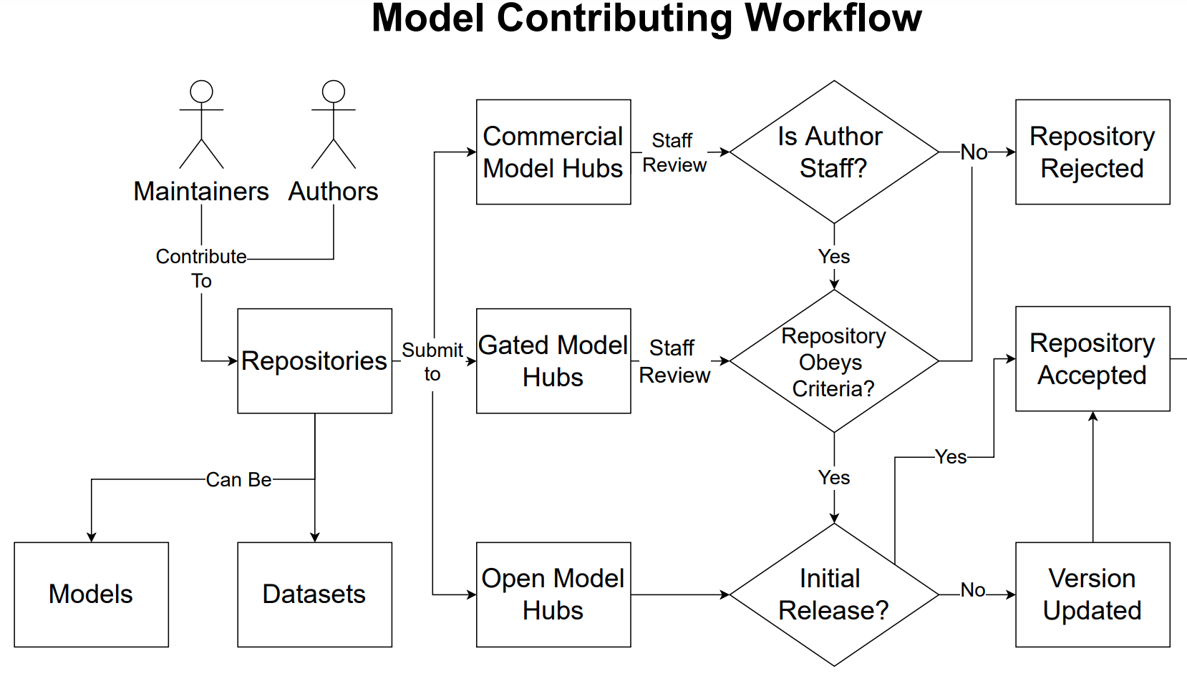


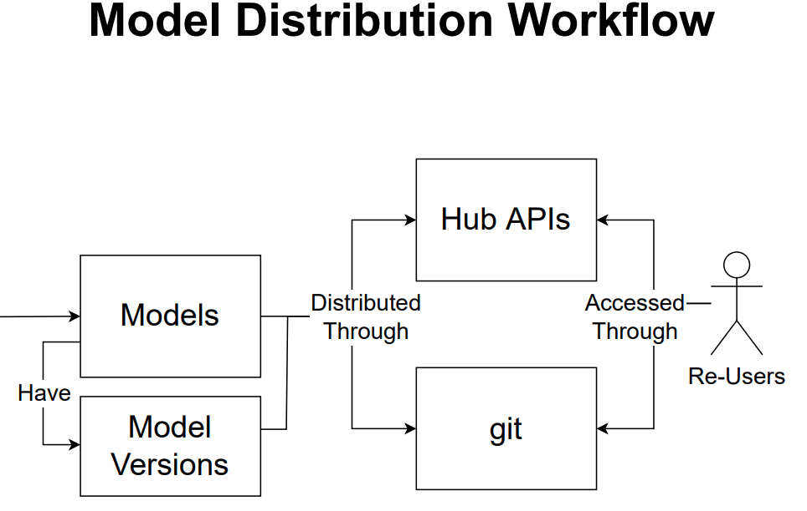
RQ1: Typical Structure of Model Hubs
Model Hubs
. . .
Three types: Open, gated, commercial
Contributing workflow: different
Distribution workflow: similar
24
Notes:
The contributing workflow:
Different types are different
Distribution workflow:
Models are distributed through client libraries, or which is called Hub APIs which are implemented by model hubs, such as HuggingFace.
Or some model hubs directly distribute repositories hosted on a cloud version control system such as GitHub.
Putting together, we have the contributing workflow, distribution workflow, and model versioning. The re-users here can also be the model authors or maintainers. This generate a supply chain kind of thing. We call this figure as the PTM supply chain!

Slide 25
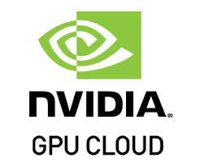




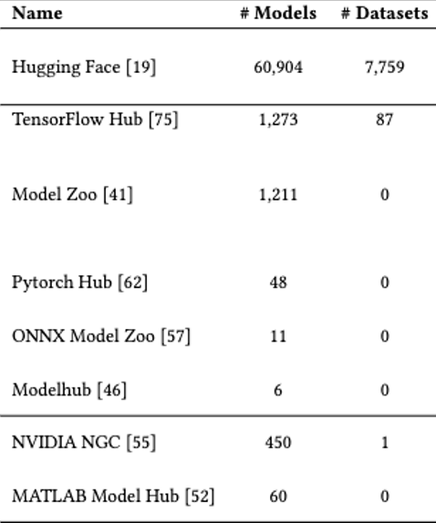
RQ2: Security Practices
Accessibility-security tradeoff
App stores
2.87M 1.96M
Open → Existing security features cannot cover all risks.
Permission model
Organization verification
Commit signing
Commercial & Gated → More secure due to controlled access
25
Notes:
To better understand the security features and identify potential problems, we studied different model hubs.
(click)
Here are some examples for each model hub type
(click)
Here are the #models and #datasets in these model hubs
(click)
For open model hubs, here we mean (HuggingFace specifically):
We measured three security features: user permission model, organization verification, and commit signing. More details can be found in our paper.
We found that these security features are not widely used and thus can present potential risks and vulnerabilities for the reusers.
(click)
For commercial and gated model hubs:
Due to the controlled access of these model hubs, they restrict access to a trusted set of users, there is less risk that a change to a model is malicious.
(click) During our study, we found that there exist an accessibility-security tradeoff in these model hubs.
(click) Analogous to the app stores, the less accessible the model hubs are, the less risks the contributors and reusers will have.
*** Bonus:
Permission model: HF has two types of accounts, personal account and organizational account. User permissions for organizational accounts are assigned globally so that users will have the same permissions to all the repositories hosted under that organization.
Organization verification:
This is an optional feature that organizations can opt into to provide a verification badge on their accounts.
The purpose of verification is to prevent other organizations from squatting on well known companies or organizations.
However, we found that many organizations have not opted into this optional feature. An organization can provide a link to a website and GitHub account without having to go through HF manual verification.
Commit signing: The purpose is to validate that a commit originated from a specific individual on a specific machine.

Slide 26
RQ3: Potential Threats
Threat Models:
Insider: maintainers, contributors → weight poisoning, backdoor, data manipulation
Outsider: users → model and data stealing
Insider
. . .
Insider attacks
Insider attacks
Outsider attacks
Outsider
attacks
Outsider
26
Notes:
Threat Models
An insider attacker profile is one that exists within the model hub organization themselves.
(click)
E.g. maintainers and contributors which are part of the contributing workflow.
(click)
All types of model hubs open the gate for weight poisoning attacks, backdoor attacks, and data manipulation when an insider is in play.
(click)
Outsider attacker profiles are derived from the model hub users. Which are part of the distributing workflow
(click)
For an open model hub, these attackers can cause damage by maliciously changing data within specific artifacts to affect users and the ecosystem.
For commercial and gated model hubs, the outsider attackers are users who do not have more than a “read-only” access to the models. An outsider in such case can perform a stealing attack, where they could rebuild the data and model from the PTM "black-box".

Slide 27
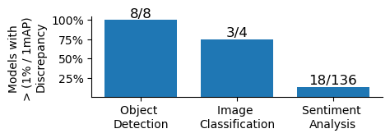
RQ3: Potential Threats
Maintainers’ reach graph
1 maintainer → 1000+ PTMs
→ Model hub is vulnerable
Model discrepancies
Inaccurate documentation exist
→ Users’ awareness and the detectability of PTM attacks
27
Notes:
Potential Risks:
Maintainers’ reach graph
The figure shows that how many repos are maintained by each maintainer.
The maintainers’ misbehavior can become an insider attack and do harm to the PTM supply chain.
(click)
This figure shows a small number of maintainers have access to a large number of repositories. By compromising one of these accounts, attackers could influence hundreds of models and thus do harm to the PTM supply chain too.
Model discrepancies:
Model discrepancies : Documented and actual performance of PTMs may be different when users run the models
These discrepancies can be caused by either insider or outsider attackers. When a model’s documentation is thorough and accurate, model discrepancies are more likely to indicate potential PTM attacks. However, the lack of proper documentation prevents users from adequately assessing the models they use.
(click)
We identified the existence of inaccurate documentation in HF, as shown in the figure.
There are totally 53 object detection models, 26 image classification models, and 160 sentiment analysis models, of which only 8, 4, and 136 provided auditable claims.
Some of the models have more than 5% discrepancy, even when they were from major technology companies.
(click)
Why: The presence of performance discrepancies could either decrease the users’ awareness or the detectability of PTM attacks.
***
To summarize our finding for RQ3:
Insider and outsider attackers can both exist in the PTM supply chain, but perform different attacks.
We proved the possibility of potential risks by analyzing the model discrepancies and maintainers’ reach graph

Slide 28
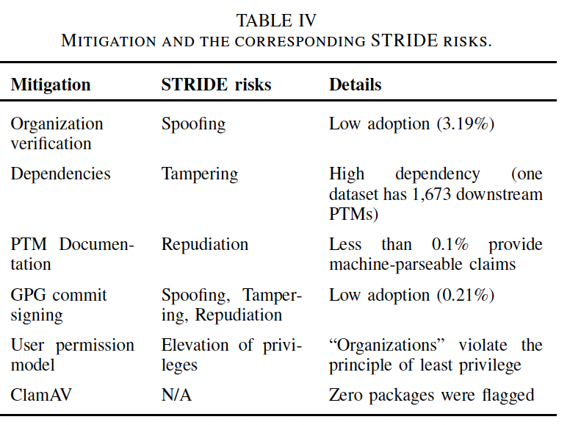
Mitigations? A critical look at HuggingFace

Slide 29
Observations → Open problems
Differences from traditional software supply chain
Versioning
→ Empirical study
Traditional software supply chain → PTM supply chain
Security risks
→ Automated tool
Model audit → PTM behavior
Model scanning → PTM attacks
Claim: For PTMs, we cannot just imitate traditional software package registries
Next project!
29
Notes:
Comparing to traditional software supply chain, the PTM supply chain has different characteristics, in terms of the nature of software versioning and security risks
Versioning:
The requirements for time and computational resources in the PTM training mean it’s hard to regularly update the PTM versions.
it’s more difficult to quantify the change between different versions because differences between the training dataset, methods, or hardware configurations can dramatically impact the quality of the resulting model.
And the current practices in the PTM supply chain lack auditability of these changes.
(click)
Empirical study:
The security characteristics of PTM supply chain remain under-discovered. We call for expanding our knowledge of traditional supply chain management to encompass DL software supply chains, including studies on dependencies, maintainers, and security issues.
Security risks:
PTM attacks are highly variable and have significant impacts if they are deployed in safety-critical systems such as autonomous vehicles.
The manifestation of PTM attacks can be different from traditional attacks. Thus traditional scanning tools are not enough in PTM context.
(click)
Automated tools:
Model audit: checking of different PTM behavior is a necessary approach to validate existing PTMs.
Model scanning: specific integrated scanning tools for PTMs are needed for iproving the security of model hubs.

Slide 30

Discrepancies among Pre-trained Deep Neural Networks: A New Threat to Model Zoo Reliability
Diego Montes, Pongpatapee Peerapatanapokin,
Jeff Schultz, Chengjun Guo, Wenxin Jiang, James C. Davis

Slide 31



Model Zoos – PTNNs
Past research has emphasized difficulties in reproducing machine learning research papers. These difficulties may affect the PTNNs in model zoos too!
Model Zoos take well-known deep neural network architectures, often from research papers, and implement them.
Deep Residual Learning for Image Recognition proposed the ResNet architecture
PTNN named "ResNet v1" implemented with the TensorFlow API
PTNN named "ResNet v1" implemented with the Keras API
PTNN named "ResNet v1" implemented with the PyTorch API
31

Slide 32
Research Question
Do discrepancies exist between the accuracy, latency, and architecture of PTNNs across different model zoos?
32

Slide 33
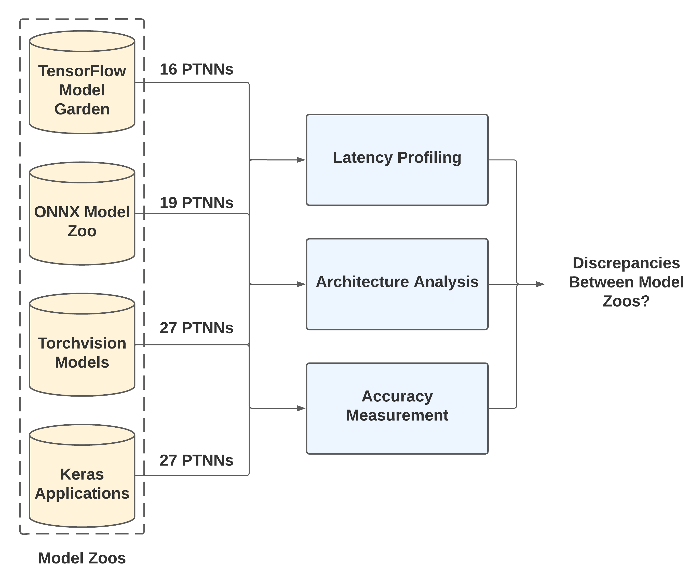
Model Zoo Selection
Keywords in GitHub Search
Selection criteria:
Developed alongside machine learning framework
GitHub repository with at least 3000 stars
Measurements highlighting important qualities of a DNN
4 model zoos after PTNN availability analysis
36 PTNN image classification architectures
33

Slide 34
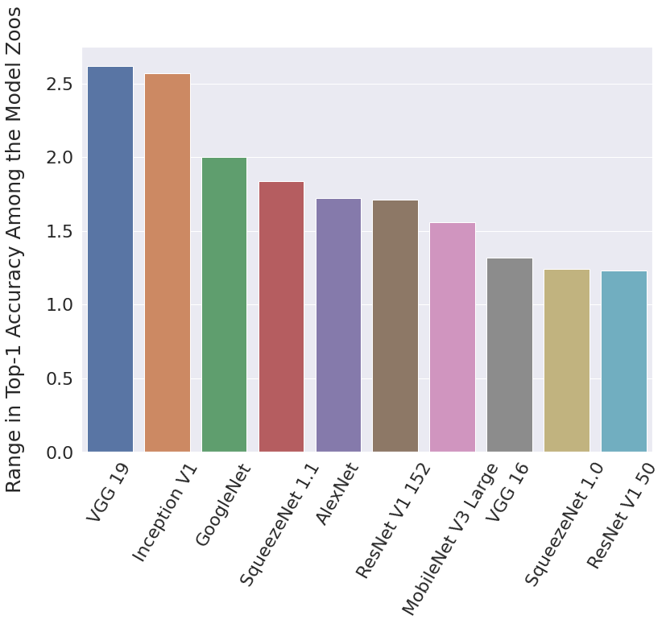
Accuracy Latency Architecture
10 of 35 PTNN architectures with top-1 accuracies differences greater than 1%
5 of 32 PTNN architectures with top-5 accuracy differences greater than 1%
ResNet V1 152 from Keras, 76.6% top-1, less accurate than ResNet V1 101 from Torchvision, 77.3% top-1
ResNet V1 101 was originally reported to be 0.32% less accurate than ResNet V1 152
34

Slide 35
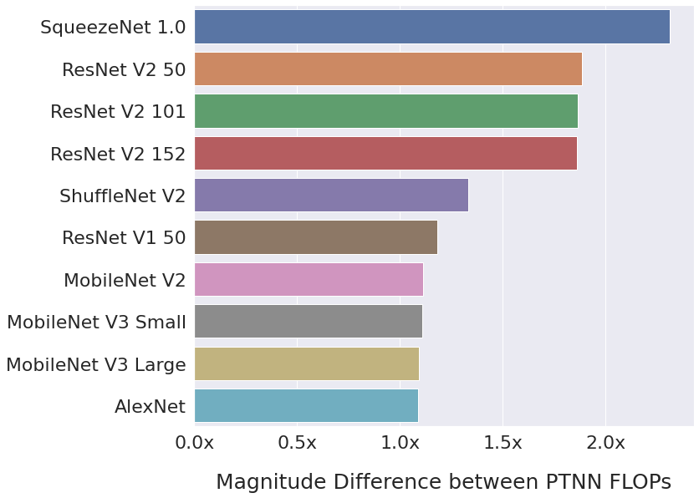
Accuracy Latency Architecture
35

Slide 36
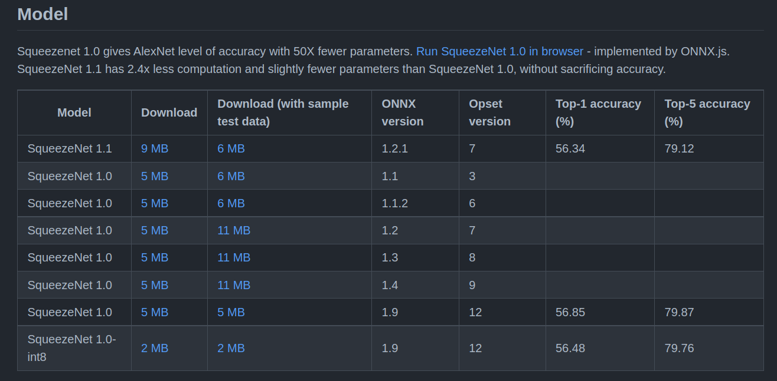
Accuracy Latency Architecture
All these models are Squeezenet 1.1!
Misadvertising SqueezeNet 1.1 as SqueezeNet 1.0 by ONNX Model Zoo
36

Slide 37
Accuracy Latency Architecture
TensorFlow Model Garden changing input size from 224x224 to 299x299
37

Slide 38
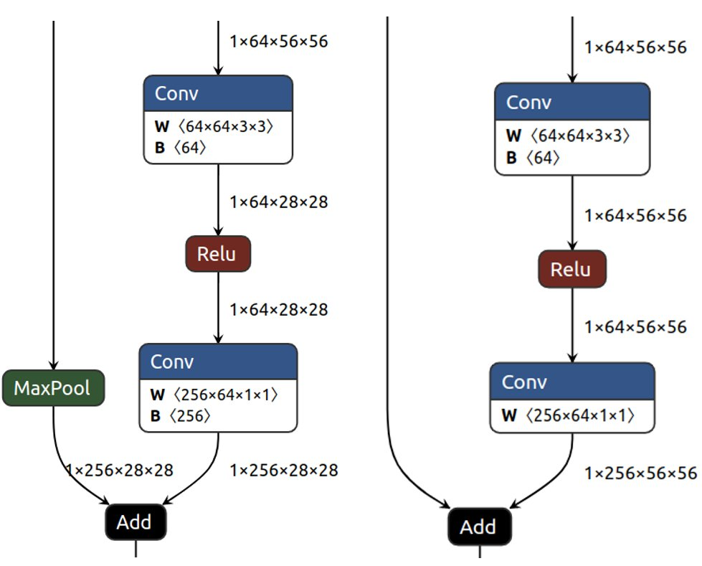


Accuracy Latency Architecture
ResNet V2 50:
Keras PTNNs contains Max Pool skip connections not present in research paper
AlexNet:
Torchvision implements different paper by the same author but calls PTNN "AlexNet".
38

Slide 39
Observations → Open problems
Naming Conventions
How should we name PTNNs?
New Metrics and Automated Tools
Metrics to further measure reliability
Automated measuring of PTNN characteristics
Do these concerns arise in engineering practice?
Next project!
39

Slide 40
Engineering reuse process
Deploy
Any danger?
Adapt candidate(s)
What is prioritized?
What is challenging?
Evaluate candidates
What is available?
What are the risks?
Identify candidates
Specify problem
What if we fail to re-use?
Notes:
Audience engagement – Help me through animation, and did I miss any steps?
Of course, doesn’t always work in a linear way.
Sequence for ParMOO
What about for PTMs? Should work in a similar way – walk through verbally
- Pop up RQs we consider

Slide 41
An Empirical Study of Pre-Trained Model Reuse in the Hugging Face Deep Learning Model Registry ICSE’23 Jiang, Synovic, Hyatt, Schorlemmer, Sethi, Lu, Thiruvathukal, Davis
Notes:
Deep Neural Networks (DNNs) are increasingly being adopted in software systems. Creating and specializing DNNs from scratch has grown increasingly difficult as state-of-the-art architectures grow more complex. Following the path of traditional software engineering, machine learning engineers have begun to reuse large-scale pre-trained models (PTMs) and fine-tune these models for downstream tasks. Prior works have studied reuse practices for traditional software packages to guide software engineers towards better package maintenance and dependency management. We lack a similar foundation of knowledge to guide behaviors in pre-trained model ecosystems.
In this work, we present the first empirical investigation of pre-trained model reuse. We interviewed 12 practitioners from the most popular PTM ecosystem, Hugging Face, to learn the practices and challenges of PTM reuse. From this data, we model the decision-making process for PTM reuse. Based on the identified practices, we describe useful (and commonly omitted) attributes for model reuse, including provenance, reproducibility, and portability. We substantiate the identified challenges with systematic measurements of trust and model risks in the Hugging Face ecosystem. Additionally, we publish HFTorrent as an open dataset for Hugging Face models. Our work informs future directions on optimizing deep learning ecosystems by automated measuring useful attributes and potential attacks, and envision future research on infrastructure and standardization for DL model registries.

Slide 42
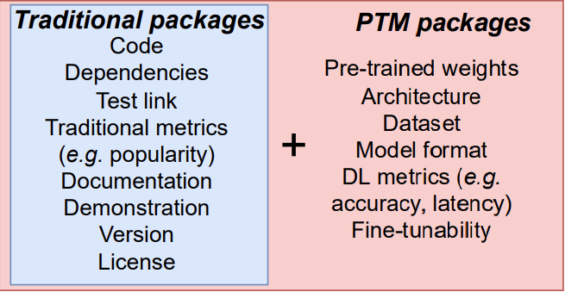
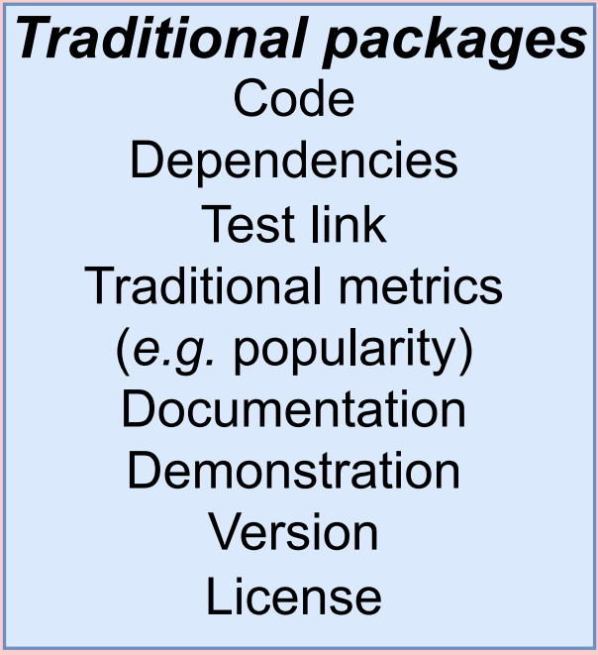



What’s in a Pre-trained Model Package (PTM)?
Package components:
Notes:
A PTM package is similar to traditional packages,
But it can include some DL-specific parts.
(Click)
E.g. pre-trained weights, training datasets, DL-specific metrics
Due to the different reuse scenarios of PTM packages (e.g. complicated model selection process, and costly evaluation loop)
The characteristics of PTM packages are different from traditional software packages
And few studies have explored this topic yet
(Click)
There are several model hubs/registries that provide PTM packages
HF, Pytorch hub, ONNX model zoo, modelhub

Slide 43
Usage Example of PTM Package
Fine-tuning
→
roberta-base (Fill-mask)
roberta-base-squad2
(Question Answering)
→
Upstream PTM
Downstream Tasks
Plug in
Transfer learning (fine-tuning)
Knowledge distillation
Dataset labeling
…

Slide 44
Lack of Knowledge
How is this similar to / different from regular packages?
Little literature about DL software packages (PTMs)
Reuse and trust are unexamined in DL model registries
No dataset available for conducting further analysis
Notes:
The goal of this work is to:
discover the similarities and differences between PTM packages and regular software packages.
(Click)
There are mainly three gaps in this problem domain:
Little work has studied DL software packages, which are PTMs.
The potential reuse and trust problems are unexamined in DL model registries.
There is no dataset available for conducting future analysis for PTM specifically.

Slide 45
Research questions
How do engineers select PTMs?
What are the challenges of PTM reuse?

Slide 46
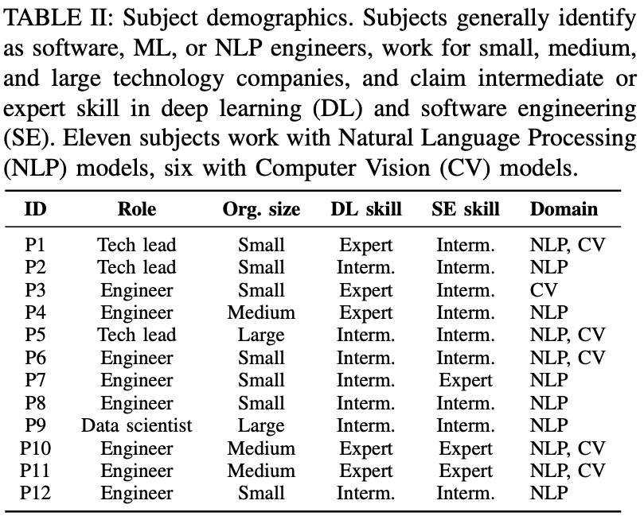
Who did we talk to?
Notes:
Recruitment:
Subjects generally identify as software, ML, or NLP engineers; work for small, medium, and large technology companies, and claim intermediate or expert skill in deep learning and software engineering.
I want to acknowledge this bias towards expertise. We identified the processes and challenges of expert users. (Presumably novices also face these challenges, but may have other concerns as well.)
====
Data collection:
We designed a semi-structured interview
protocol with questions that explore the three identified themes from the research literature: model selection, PTM attributes, and PTM trustworthiness.
We conducted three pilot interviews.
We then revised our framework and interview protocol, adding
some PTM attributes and factors and clarifying definitions.
We recruited users from the Hugging Face
ecosystem [42], who presumably have experience in developing
and reusing PTMs. According to the Hugging Face
website [69] there are 18,348 Hugging Face users, 690 of
whom have PRO accounts and 17,658 of whom have regular
accounts. We sorted the lists of PRO and regular users by the
number of models they have contributed to Hugging Face, and
contacted the first 50 users of each type. We interviewed the
12 respondents described in Table II. This was a (response
rate of 24%, of whom 9 had PRO accounts. Our participants
contributed between 4 and 2500 models to Hugging Face

Slide 47
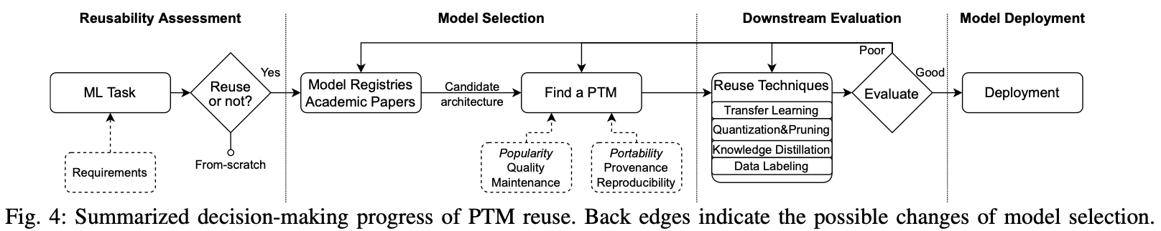
RQ1: How to decide which PTNN to reuse?
Notes:
Summarized decision-making process of PTM re-use. Backedges indicate possible iteration or changing the selected model.
When reusing, participants find PTMs from DL model registries easier to adopt than PTMs from GitHub projects, because of usability features. The participants share a similar four- stage decision-making process (Figure 4).
Engineers begin the decision-making process with a reusability assessment. Before selecting a model, engineers must identify a ML task and determine if model reuse is appropriate. An ML task is determined by a set of requirements. These requirements include items such as: model input, model output, cost, data, size, licensing, latency, etc. Engineers must then decide if they should reuse a PTM or create a solution from-scratch. For example, three participants (P8, P9, P11) reuse PTMs because they “do not have enough computational resources”. In a similar manner, participants (P2, P5, P8, P9, P11) note that DL model registries provide inference APIs to simplify reuse — PTMs are “easy to use and test”.
Once engineers decide to reuse a model, they must select an existing architecture and an associated PTM. Engineers search for a candidate architecture with promising characteristics by browsing model registries or relevant papers. Most of our study participants prefer to search through model registries than to use GitHub or the open internet. For example, participants (P1, P4, P6) said they can “easily find a model” in model registries due to clear classification at the domain (e.g., computer vision, natural language processing) and task (e.g., text generation, image classification) levels.
Commonly, they select PTMs from leading technology companies (e.g., Google, Meta) because “the datasets are carefully cleaned and really easy to take and put into the fine-tuning or transfer learning algorithms”.
After selecting one or more PTMs, engineers conduct a downstream evaluation for their specific task. Engineers often assess multiple candidate PTMs in this stage. Participants in our study tend to care about the model’s performance and architecture. P7 noted that they will not choose a “weird architecture” even if its documented performance is higher.

Slide 48
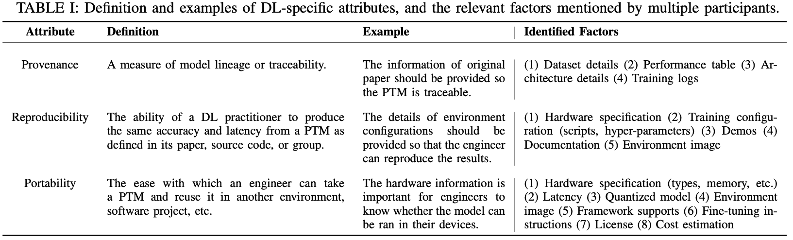
RQ1: What attributes are key for PTNN reuse?
Notes:
For Traditional attributes, Popularity is most helpful.
Provenance, Reproducibility, and Portability are the three DL-specific attributes we should consider.
Reproducibility is the most problematic aspect of PTMs. The reproducibility issues mainly come from two aspects: (1) the configuration of training (2) the understanding of model. For the training configuration, the participants tend to care more about the hardware specification (e.g., types, memory), training configuration (e.g., training scripts, hyper- parameters). As a result, they feel like environment images would be helpful to help them easily configure the settings and make the model more reproducible. In terms of understanding of the models, different kinds of demos (e.g., Notebook demo, Fine-tune demo) and better documentation would help a lot.
Some participants think that maintenance and quality are less useful. Recall from §V that most reuse scenarios are fine-tuning on new datasets or tasks. So as long as the model is fine-tunable, some subjects mentioned that maintenance and quality metrics are “less useful in down- stream tasks”. P12 suggested that maintenance may be less relevant because of the cost of making changes — “it is really hard to modify the PTM...there were some issues during pre- training” in a large language model, but the model has not been retrained “because it is too large”

Slide 49
RQ2: What are the main challenges of PTNN reuse?
Missing attributes 10/12 participancts
Discrepancies 9/12 participants
Security concerns 3/12 participants
Notes:
Missing attributes is the most challenging problem. Almost every participants mentioned that there are missing details in the model registries, including datasets, licensing, model details, robustness, and interpretability
The existing discrepancies is another main challenges mentioned by most participants. For example, the claimed performance (accuracy, latency) may differ from the actual performance. P7 pointed out that “some of the models are over-promising”. P2 indicated that another reproducibility issue is that the “model names are not named correctly and sometimes the provided scripts are broken”

Slide 50
RQ2: Reuse Challenges: Why PTM reuse is hard?
Missing attributes:
“Missing details of models”
“Performances of the published models are unclear”
“Different authors process data differently, so it cannot be easily compared”
Discrepancies:
“Some of the models are over-promising”
“Model names are not named correctly and sometimes the provided scripts are broken”
Security and Privacy Risks:
“The model deployment and data transmission are not in their control”
“It is hard to know what exactly generated the model because most training logs are missing”
“If the model is trained with malicious intents. It could have a lot of consequences in the real world”

Slide 51
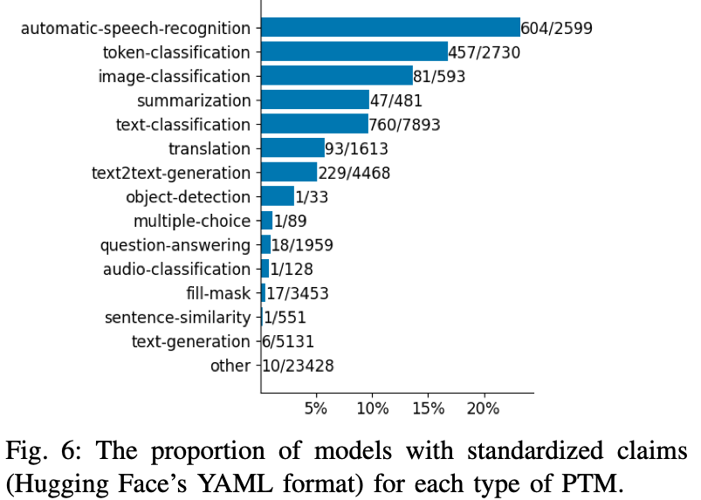
RQ2: How often are PTNN attributes missing?
Notes:
What are the axes?
What is the interpretation?

Slide 52
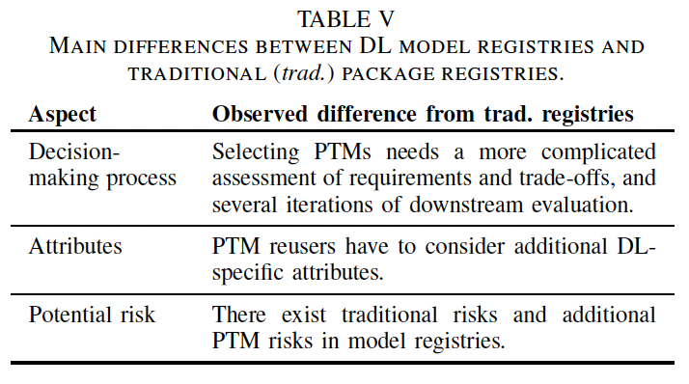
Observations → Open problems
Recommend we focus on:
Addressing the complexity of re-use decision-making
Measuring relevant package attributes (Popularity vs. Quality/Maintenance)
Notes:
We compared to prior work examining reuse practices for traditional software (e.g. Java packages, regular expressions). Our data suggest that the decision making of PTMs are more complex than the reuse of traditional packages, in terms of the iterations and factors needed during the decision-making process. Our subjects reported more loops and a longer time to decide whether to reuse a given PTM – up to weeks and months!
For Traditional attributes, Popularity is most helpful for PTM reuse, while Quality and Maintenance are less useful compared to traditional packages. This differs from traditional software reusers, who consider quality and maintenance of packages as important as popularity when selecting and reusing the pack- ages [16,27,75]. This difference comes from the expensive cost and data-driven nature in PTMs. It is hard for PTM users to directly take and employ an existing model. Dislike taking a package from NPM or PyPi and directly reuse it in the codes, PTM reuse needs a deeper understanding and knowledge of how it works. However, “there are not quite reliable methods to measure the explainability of PTMs yet”, as indicated by P10. Therefore, to better reuse the PTMs, the engineers need more information from the model registries, which result in the requirements for DL-specific attributes.

Slide 53
Engineering reuse process
Deploy
Any danger?
Adapt candidate(s)
What is prioritized?
What is challenging?
Evaluate candidates
What is available?
What are the risks?
Identify candidates
Specify problem
What if we fail to re-use?
Notes:
Audience engagement – Help me through animation, and did I miss any steps?
Of course, doesn’t always work in a linear way.
Sequence for ParMOO
What about for PTMs? Should work in a similar way – walk through verbally
- Pop up RQs we consider

Slide 54
Analysis of Failures and Risks in Deep Learning Model Converters: A Case Study in the ONNX Ecosystem arXiv’23 Jajal, Jiang, Tewari, Woo, Thiruvathukal, Davis
Notes:
Once you go to all this work to identify candidates, evaluate them, and adapt them, it would be a shame if you lost some performance during deployment. Let me give you a quick overview of a study we did on this topic.

Slide 55
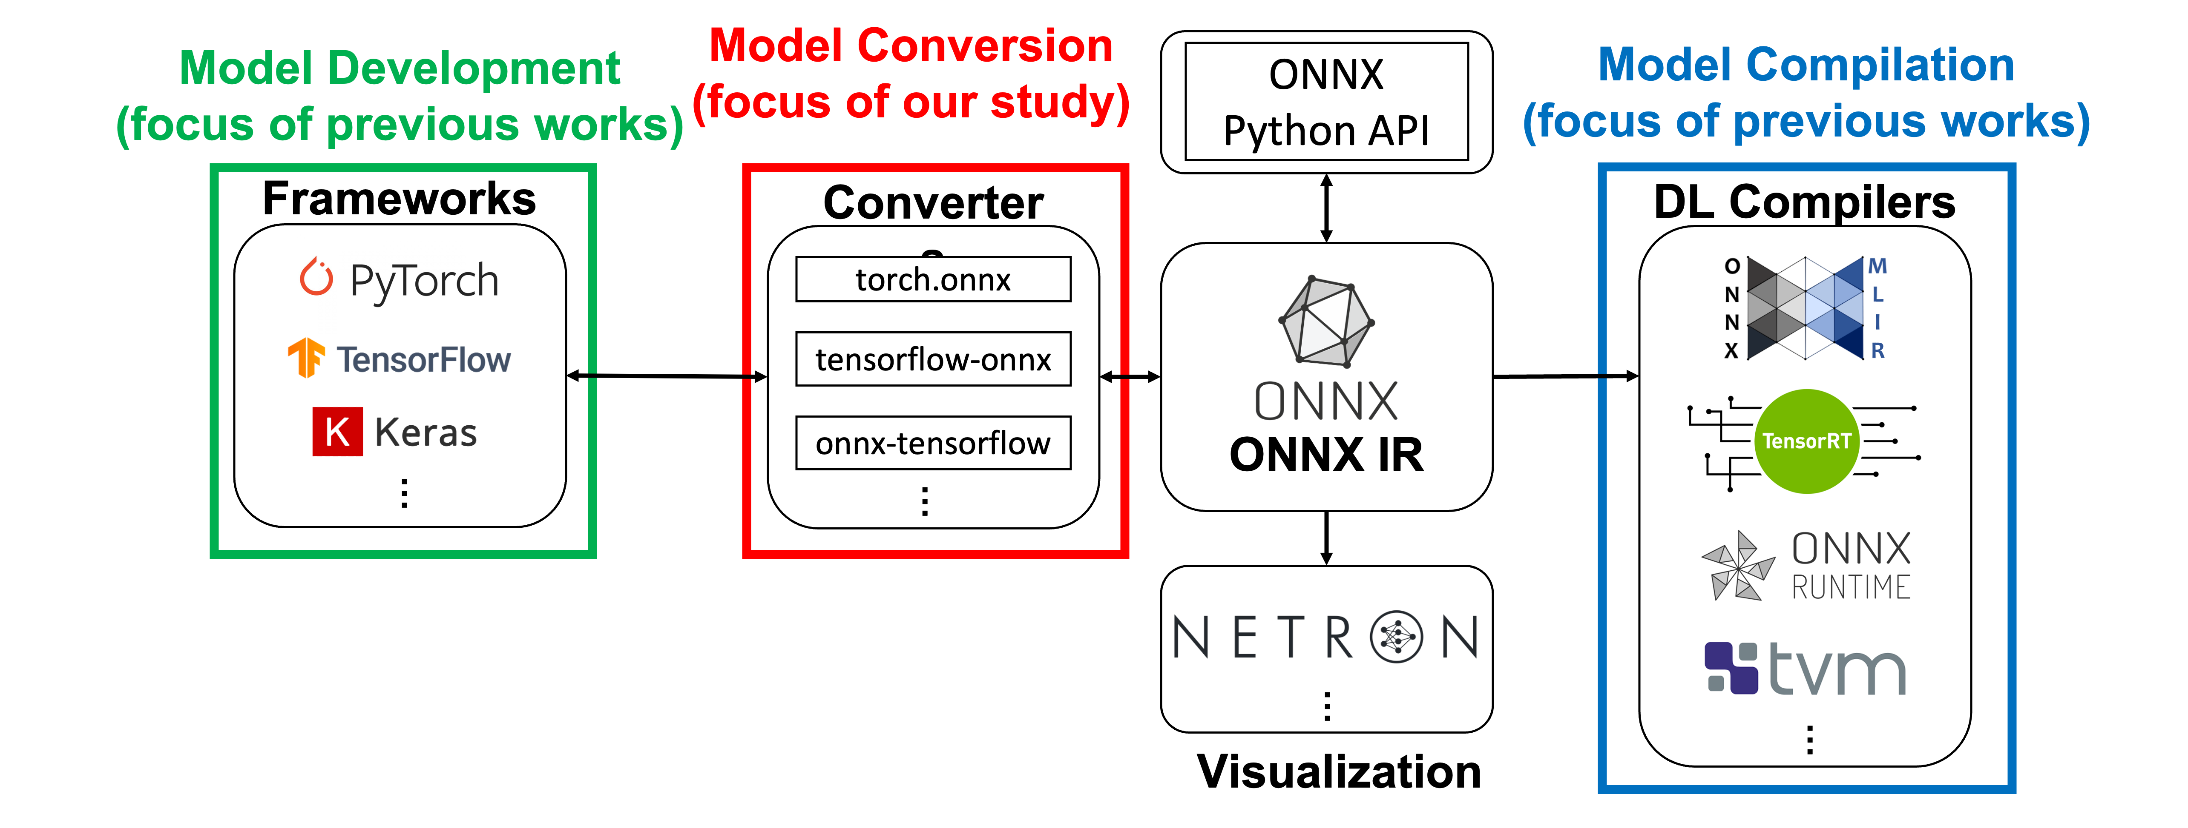
Background: Model converters
Notes:
Wegner describes two patterns for interoperability: creating pairwise mappings between systems; and introducing a common intermediary understood by all participants [23 ]. These patterns are illustrated in Figure 1 in the context of DL. The two patterns trade- off customizability for scalability. A system with pairwise mappings can have specialized behavior per pairing, but each of the 𝑁 data loaders must maintain a mapping for each of the 𝑀 data generators. The alternative pattern uses a common intermediary such as an intermediate data representation. Each system maintains only one export or import mechanism, reducing the overall implementation burden for the ecosystem from 𝑀 × 𝑁 adapters to 𝑀 + 𝑁 adapters. We expect that scalability becomes more important as ecosystems expand, causing an ecosystem’s interoperability approach to evolve from pairwise mappings to common intermediaries
DL compilers allow deploying models to specific hardware [29]. DL compilers include TVM (Apache), TensorRT (NVIDIA), and OpenVINO (Intel) [7, 30 , 31 ].1 We count at least 10 compilers since 2017 with each offering varying degrees of framework support (direct conversion from 1 to 6 frameworks) but almost all (9/10) supporting ONNX. This data is available in our artifact

Slide 56
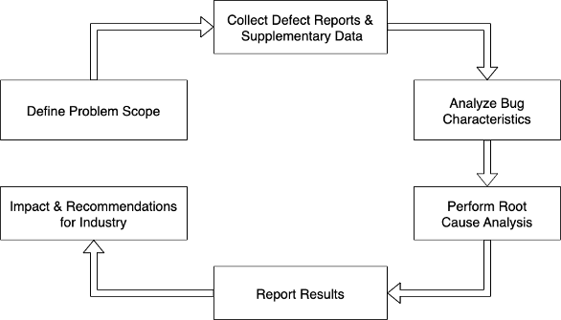
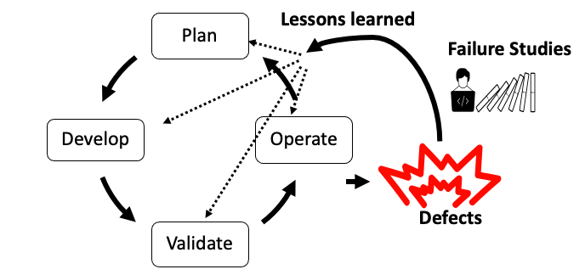

Background: Failure Analysis
Notes:
In the software development life cycle, we plan a software project, build and validate it and everything seems to work well. But once deployed and during operation, things break, bugs happen. These bugs are undesirable. To better understand these bugs, academic researchers or industry investigators conduct failure studies. The goal is to learn lessons from these failures. There are two audiences for such work: (1) the product engineers, who want to reduce occurrence of these bugs; and (2) the product users, who want to understand their risks when they use the product.

Slide 57
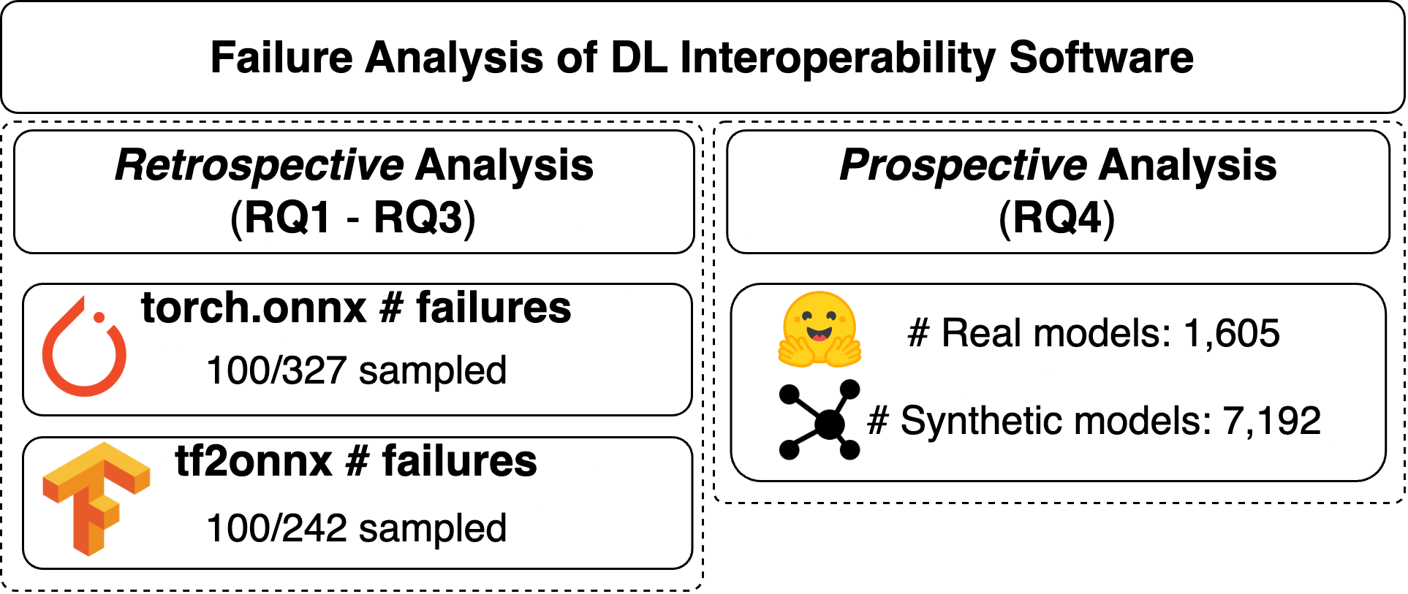
Method Overview
Notes:
Our work studies two model converters: pytorch converter (torch.onnx) and tf2onnx (the tensorflow converter).
And we study these converters in two ways:
- Retrospectively: we study 100 Closed GitHub issues reported for each converter. This provides a historical perspective on how thing have failed in the past.
- Prospectively, current users care about how they currently behave. So we test these converters with many different DL models, both real (i.e., pretrained) and synthetic (i.e., randomly generated).

Slide 58
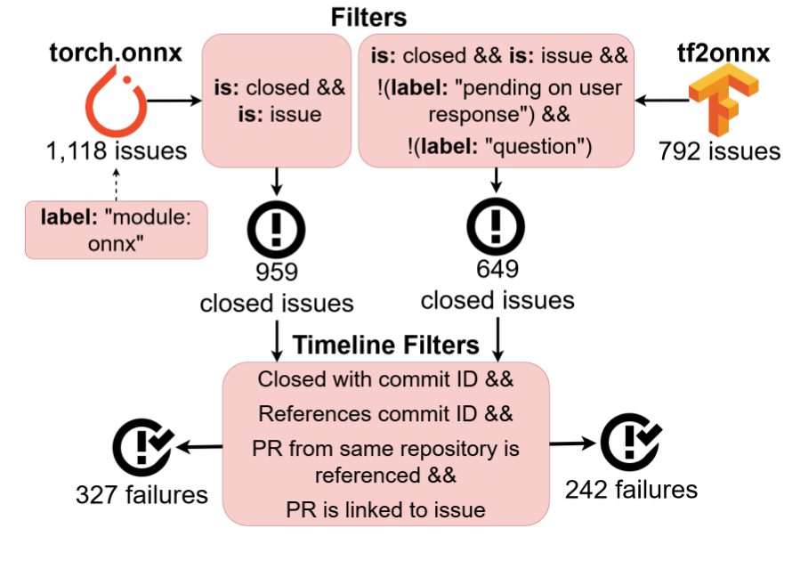
Method: Retrospective analysis: Issue selection
Notes:
We can skip this slide.

Slide 59
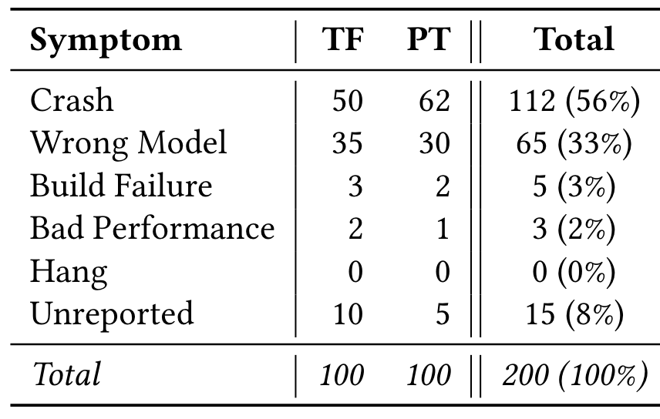
RQ1: Failure Symptoms
Common Failure Symptoms:
Crashes
Wrong Models
Notes:
When we ask what the failure symptoms are, what we are asking is what are the effects of the failure that users have seen?
We measure that: converter crashes and incorrectly converted models (wrong models) are the most common failure symptoms.
Crashes occurred in 56% of the studied failures.
Wrong Models occurred in 33% of the studied failures.

Slide 60
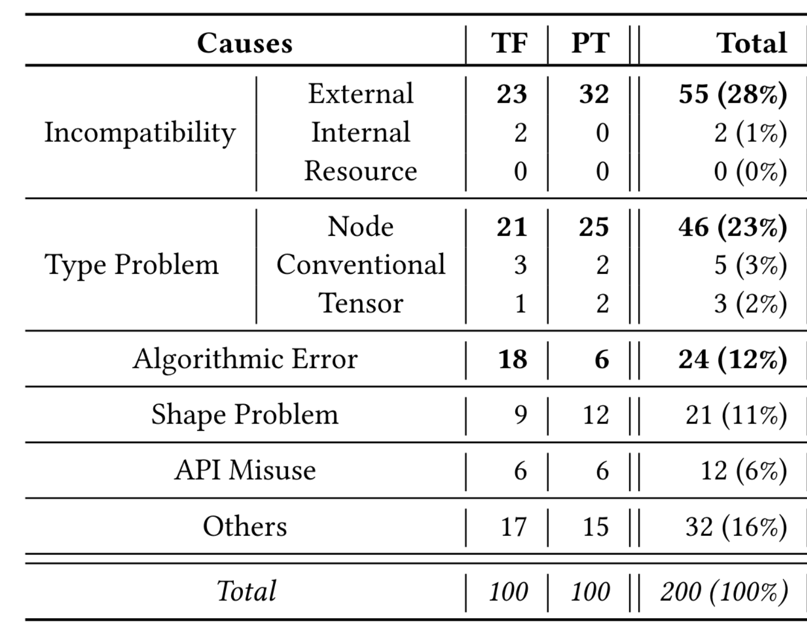
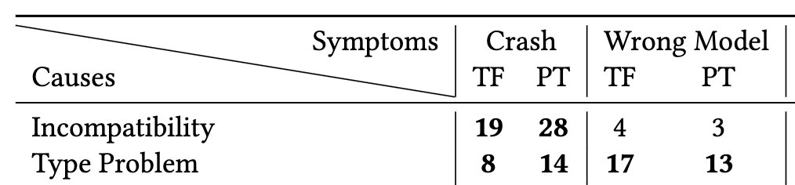
RQ1: Failure Causes
Common Causes:
Incompatibilities – External
Type Problems – Node
Notes:
In addition to failure symptoms we also look at the causes of these failures. There are two common causes of failures:
External Incompatibilities which make up 28% of failures, which essentially means that many of the failure that were found were people trying to convert to ONNX but being unable to due to an operation not be supported.
Node Type Problems which make up 23% of failures. These are issues pertaining to the conversion of nodes, e.g. mistaking one layer type for another
Also perhaps of interest are the algorithmic errors – these are incorrect algorithms during conversion, e.g. trying to render one layer in terms of others but producing an inequivalent result

Slide 61
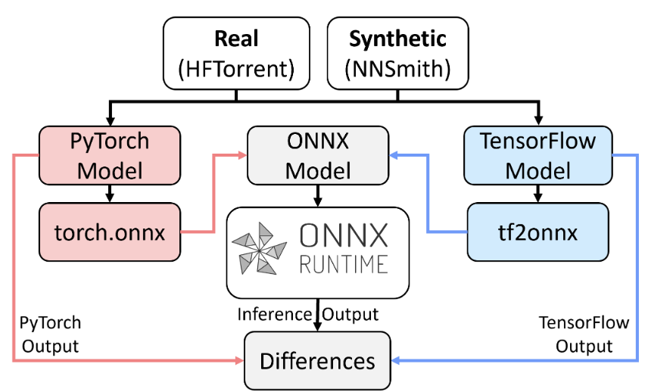
RQ4: Method
Notes:
Conversion test. Models are converted using tf2onnx or torch.onnx as appropriate. If conversion succeeds, differ- ences are measured between original and converted model.

Slide 62
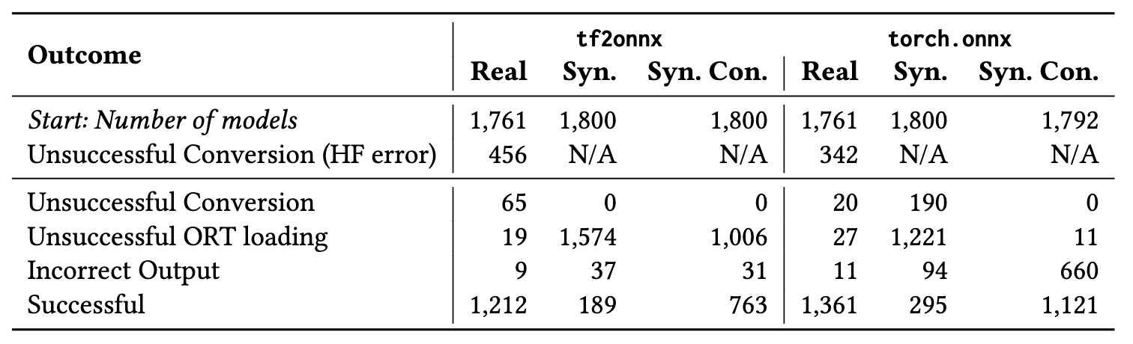
RQ3: Prospective failure discovery
Real models: Crashes and incorrect behavior → ∼5% of models.
Synthetic models: Reveal incorrect model behavior more often than Real models, ∼25% (822/7,192) vs. ∼1% (20/3,522).
Incorrect Output is when the difference in outputs of original and converted models are >10⁻³
Notes:
RQ1 and RQ2 are all retrospective analyses they don’t really tell us the current state of things. We were curious whether these issues occur in current versions of converters.
We tested model converters using two types of inputs, real models which were pretrained models taken from HuggingFace and synthetic models created using a random model generator called NNSmith.
Real models: Crashes and incorrect behavior → ∼5% of models. What we mean by incorrect behavior is when the original and converted models differ in outputs by a certain threshold.
Synthetic models: Reveal incorrect model behavior more often than Real models, ∼25% (822/7,192) vs. ∼1% (20/3,522).

Slide 63
Observations → Problems
How can we better test DL model converters?
How much error is tolerable as a result of conversion?
Notes:
Question 1:
DL model converters need better testing techniques for behav- ioral changes. This critical failure mode occurred in ∼1/3 of histori- cal failures (§5.1) and affected 8% of the models we tested (§5.3).
We inspected the test suites of the tf2onnx and torch.onnx con- verters to understand current testing techniques. These suites con- tain unit tests for individual operators and performance optimiza- tions. They also perform full model conversion tests similar to our methodology for RQ4 (§4.3). However, these tests use few large real models and no large synthetic models
Question 2:
Full model conversion tests carry with them the need to assess the outcome: is the converted model acceptable, and how much error is tolerable [ 41, 56 ]? Engineers currently use one distance measure with a fixed threshold derived from experience (§4.3.2). Em- pirical and theoretical examination of this question would benefit DL model converter testing.

Slide 64
Engineering reuse process
Deploy
Any danger?
Adapt candidate(s)
What is prioritized?
What is challenging?
Evaluate candidates
What is available?
What are the risks?
Identify candidates
Specify problem
What if we fail to re-use?
Notes:
Explain why this might happen, notably “not fast enough” or “need an implementation in a particular framework”
Low on time so just summarize what happened here.

Slide 65
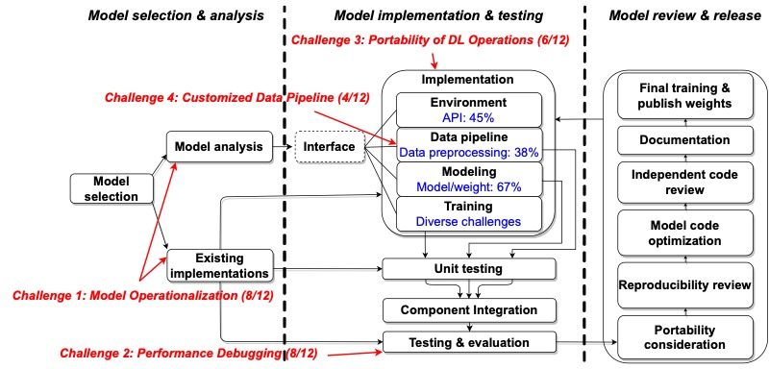
Notes:
Context: Many engineering organizations are reimplementing and ex- tending deep neural networks from the research community. We describe this pro- cess as deep learning model reengineering.
Problem statement: Deep learning model reengineering — reusing, reproducing, adapting, and enhancing state-of-the-art deep learning approaches — is challeng- ing for reasons including under-documented reference models, changing require- ments, and the cost of implementation and testing. In addition, individual engi- neers may lack expertise in software engineering, yet teams must apply knowledge of software engineering and deep learning to succeed.
Related works: Prior work has characterized the challenges of deep learning model development, but as yet we know little about the deep learning model reengineering process and its common challenges. Prior work has examined on DL systems from
a “product” view, examining defects from projects regardless of the engineers’ purpose. Our study is focused on reengineering activities from a “process” view, and focuses on engineers specifically engaged in the reengineering process.
Methodology: Our goal is to understand the characteristics and challenges of deep learning model reengineering. We conducted a case study of this phenomenon, focusing on the context of computer vision. Our results draw from two data sources: defects reported in open-source reeengineering projects, and interviews conducted with open-source project contributors and the leaders of a reengineering team. In the open-source data, we analyzed 348 defects from 27 open-source deep learning projects. Meanwhile, our reengineering team replicated 7 deep learning models over two years at a cost of about $70K; we interviewed 4 practitioners and 6 reengineering team leaders to understand their experiences.
Results: Our results describe how deep learning-based computer vision techniques are reengineered, analyze the distribution of defects in this process, and discuss challenges and practices. We found that most defects (58%) are reported by re- users, and that reproducibility-related defects tend to be discovered during training (68% of them are). Our analysis shows that most environment defects (88%) are in- terface defects, and most of environment defects (46%) are caused by API defects. We also found that training defects have diverse symptomss and root causes. We identified four main challenges in the DL reengineering process: model operational- ization, performance debugging, portability of DL operations, and customized data pipeline. Integrating our quantitative and qualitative data, we propose a novel reengineering workflow.
Future directions: Our findings inform several future directions, including: measur- ing additional unknown aspects of model reengineering; standardizing engineering practices to facilitate reengineering; and developing tools to support model reengi- neering and model reuse.
Reengineering workflow, divided into three main stages. Forward edges denote the reengineering workflow. Dotted line denotes optional (interface). Back edges denote points where errors are often identified. Red arrows indicate the main location of each challenge, with the numbers in parentheses representing the count of participants who mentioned these challenges. Blue text denotes the main root causes of failures in each DL stage.

Slide 66
Now we have many observations of PTM reuse, and many problems to tackle!
“Has someone done this already?”
Deploy
Any danger?
Adapt candidate(s)
What is prioritized?
What is challenging?
Evaluate candidates
What is available?
What are the risks?
Identify candidates
Specify problem
What if we fail to re-use?
Notes:
Thank you for your attention!

Slide 67
Bonus slides

Slide 68
Talk overview
My research approach
Background
Research results
Future directions

Slide 69
Future directions
We want to know more about the PTM supply chain!
We need more to ensure its security!

Slide 70
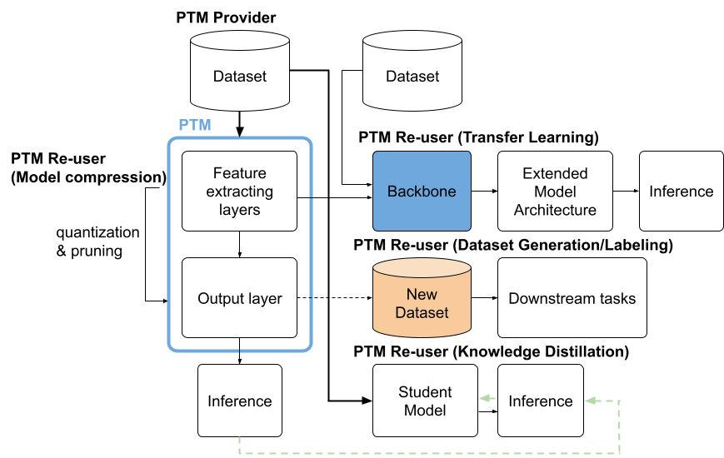
Security Risks on and with PTMs
Security vulnerabilities in software supply chain
Adversarial attacks
Indirectly: data poisoning
Stealing attacks
Directly: backdoor/Trojan attacks, malware injection
Goldblum et al. "Dataset security for machine learning: Data poisoning, backdoor attacks, and defenses." TPAMI. 2022.
Wang et al. "Evilmodel: hiding malware inside of neural network models." ISCC. 2021.
70
Notes:
Security vulnerabilities
Our work build on knowledge from the traditional software supply chain and package registries and determine the characteristics of them in the PTM context
Researchers have described many attacks on PTMs. Let’s take a look at how these attacks map onto the PTM use case diagram.
(click)
Here is that diagram again
First, some attacks directly target PTMs and can either modify the models’ prediction on specific input patterns by backdoor/Trojan attack, or add side-effects by inject malware into the PTMs.
Second, it is possible to attack a model indirectly from its training dataset by data poisoning attacks
Moreover, there can also be stealing attacks. The attackers can steal either the private models used for business products or dataset like private images
.

